Slide 1

Acoustic Material Manipulator
Presented by the Levitators
Levitators: Jp Schultz, Darren Buck, Xavier Sneed, DaVaughn Williams

Slide 2

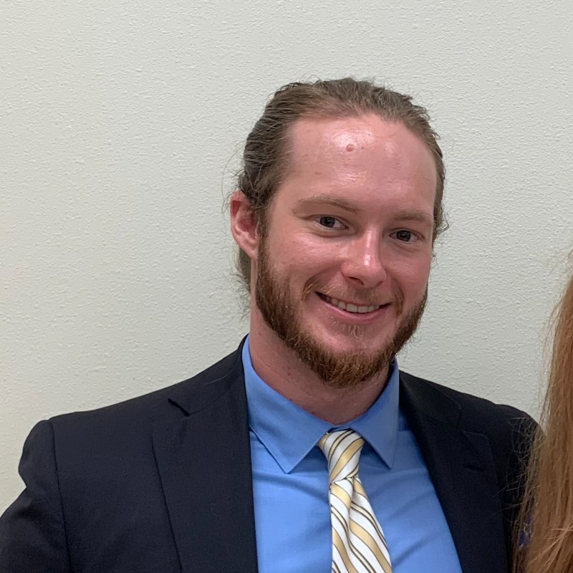
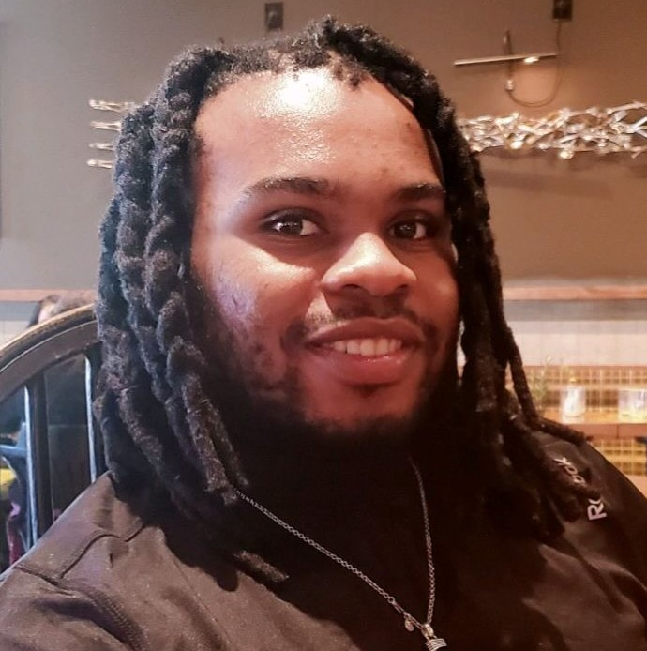

Biographies
JP Schultz
Project Manager
Darren Buck
Product Developer
Xavier Sneed
Secretary
Interest: Hardware Engineer
Skills : Pspice, C/C++, Linux, and Circuit Building
Devaughn William
Software Developer
Felipe Martinez
Interest: Computer Engineering & Music Technology
Pspice, C Programming, Circuit Building

Slide 3
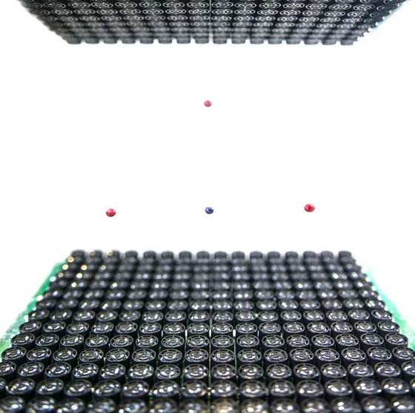
Product Description
The Acoustic Material Manipulator is a product that will utilize the science of vibrational frequencies to alter the shape and temperature of a material. Unlike products like microwaves that use a similar concept, no radiation will be emitted from the product. This project will consist of four square plates of transducers, each consisting of 64 individual speakers. The plates will be in the shape of a cube. This arrangement of the plates will allow the ability to change the shape, temperature, and even the capability to move the material.

Slide 4
Need for Product
Air Conditioning (cooling and heating)
Refrigeration.
Heating water in home appliances.
Hazardous Materials(non- contamination)

Slide 5
Market Analysis
AMM will focus on new markets in construction of new buildings and homes.
Will be focused on Industrial Markets.
Competition is to be cheaper and more affordable than other appliances.
New technology will be more ready than other appliances waiting for parts

Slide 6
Market Strategy
AMM will utilize different platforms for advertisement like social media
Develop a partnership with other established engineering companies
Diversify the application of using Acoustic Manipulator

Slide 7
Competitors
We face variety of competitors for a project similar to our manipulator:
Equium
Laird
Nirvana Energy systems
InSightec
Vesper Technologies

Slide 8
Functional Decomposition

Slide 9
Technical Work
Transducer Orienting
PCB Assembly
Transducer Structure
Wiring
Power
Software Development
Testing
Safety Enclosure

Slide 10
Budget
Part | Quantity | Cost
Transducers | 1,024
FPGA | 4 | 200
Drivers | 512 | 550
Shift-Registers | 150 | 25
Capacitors | 700 | 30
Adruino | 5 | 200
DC Barrel Connector | 6 | 35
PCB | 5 | 150

Slide 11

Questions?

